Slide 1
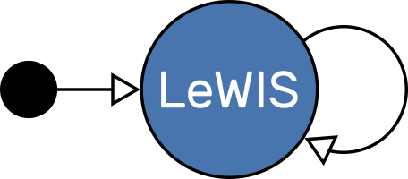
Introduction to…
A Stateful Device Emulation Framework
Michael Hart
Michael Wedel
Owen Arnold

Slide 2
Background
Need to develop user-facing control software

Slide 3
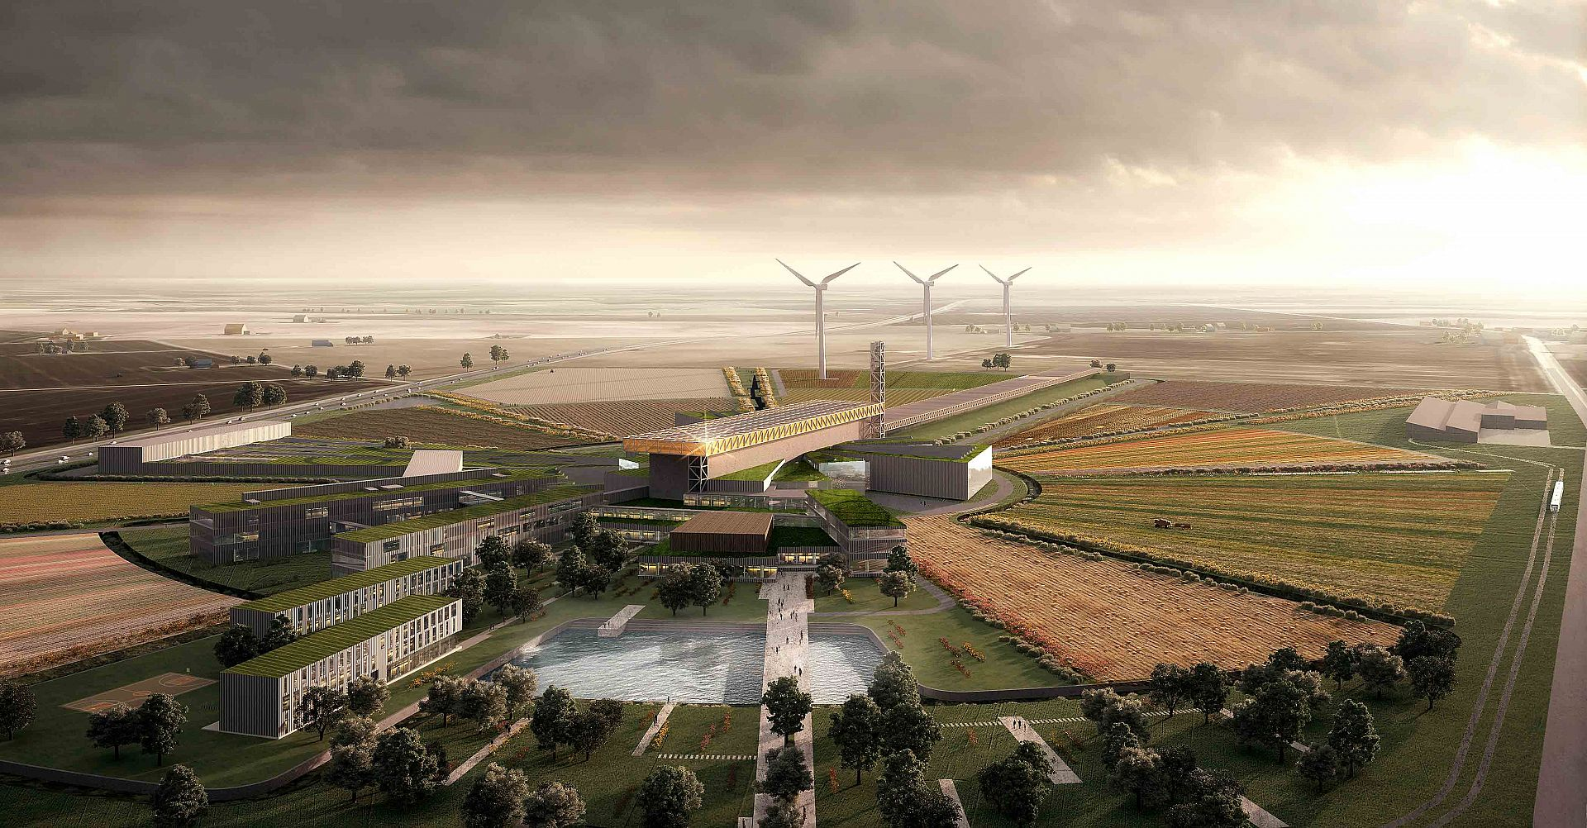
ESS Artist Rendition

Slide 4
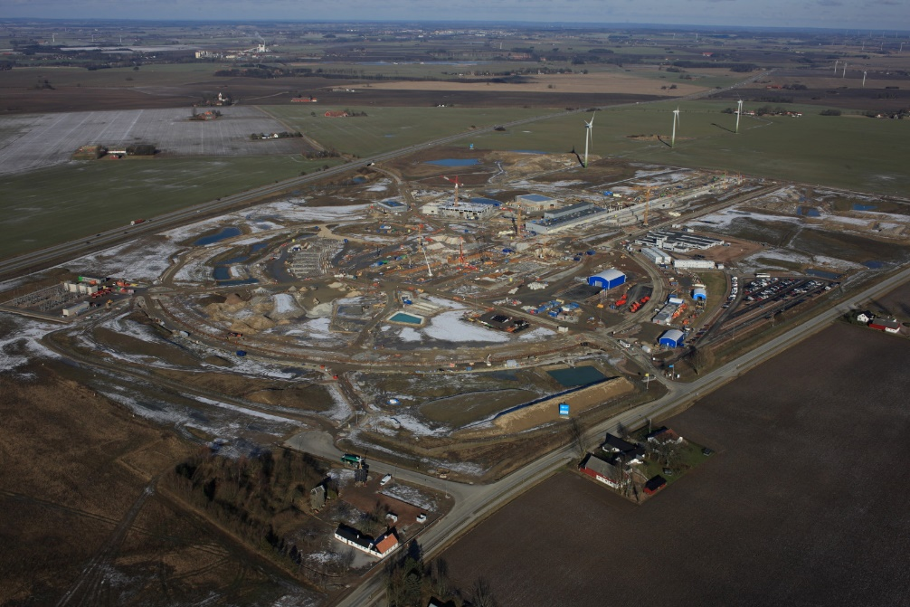
ESS Reality

Slide 5
Background
Need to develop user-facing control software
BUT….
Facility does not exist yet
Hardware not available yet
EPICS IOCs not available yet
Cannot test our work

Slide 6
Solution
Replace Devices + IOCs with software emulator

Slide 7
Replace IOC
Replace devices + IOCs with Lewis

Slide 8
Replace Device
Replace devices with Lewis

Slide 9
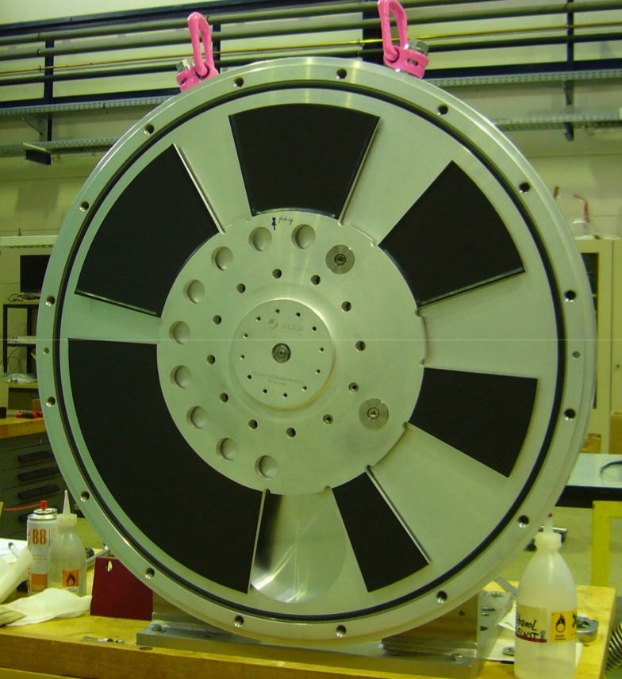
Chopper Disc

Slide 10
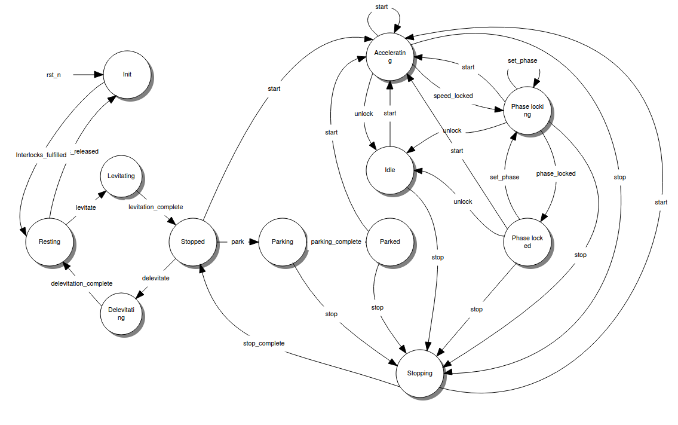
Chopper State Diagram

Slide 11
Lewis Overview
Python framework to unify common tasks
State machine to model device states
Flexible interfaces: IOC or Device-level
Cycle-driven: Deterministic and controllable time-flow
JSON-RPC to bypass normal protocol
Available as Docker image

Slide 12
Lewis Cycle-Driven Design

Slide 13
Use Cases and Applications
Development and testing of user-facing software without access to hardware
Allows testing edge conditions without stressing or jeopardizing hardware
Automated unit and system tests
Can be used to perform dry runs to test or time user scripts
Can be used in many other contexts!

Slide 14
Current State
Version 1.0.3 released March 24th 2017
Helped progress Chopper design at ESS
In use at ESS Test Beamline at HZB in Berlin
In use by IBEX team here at ISIS
Device-level emulators
Test IOC and GUI behaviour

Slide 15




Lewis Technologies

Slide 16
Where to find Lewis
GitHub
https://github.com/DMSC-Instrument-Data/lewis
DockerHub
https://hub.docker.com/r/dmscid/lewis/
PyPI
https://pypi.python.org/pypi/lewis
Install!
$ pip install lewis
$ docker pull dmscid/lewis

Slide 17
Questions
?

